Slide 1
WELCOME
How to Build Partnerships With Parents, Community Resources and District Programs
DOE
SCR184240
BRANDMAN UNIVERSITY
EDAU 9024
SCR184240

Slide 2
INTRODUCTION
How to Build Partnerships with Parents, Community Resources and District Programs

Slide 3
The world is a very complicated place!
Whether you are talking about relationships, technology, politics or education, nothing is simple anymore.
How to Build Partnerships with Parents, Community Resources and District Programs

Slide 4
At one time phones looked like this…
How to Build Partnerships with Parents, Community Resources and District Programs

Slide 5
Now they look like this…
How to Build Partnerships with Parents, Community Resources and District Programs

Slide 6
Car engines once looked like this…
How to Build Partnerships with Parents, Community Resources and District Programs

Slide 7
Now they look like this…
How to Build Partnerships with Parents, Community Resources and District Programs

Slide 8
In theory, parents would simply send their children to school and the teachers would teach them.
But like the young boy looking in the mirror, reality is not always what it seems to be.
How to Build Partnerships with Parents, Community Resources and District Programs

Slide 9
The children they are sending to school each day arrive…
-Angry
-Scared
-Hungry
-Physically abused
-Emotionally abused
-Lonely
-Sad
How to Build Partnerships with Parents, Community Resources and District Programs

Slide 10
-Tired
-On prescription drugs
-On illegal drugs
-Lacking social skills
-Dirty
-Lacking motivation
-Feeling stupid
-Afraid of being bullied
How to Build Partnerships with Parents, Community Resources and District Programs

Slide 11
-Academically behind
-Worried about what waits for them at home after school
Let’s just look at three significant changes…
How to Build Partnerships with Parents, Community Resources and District Programs

Slide 12
Think of it in terms of the issues and challenges that your students walk into your classroom every day with…
-Parents incarcerated….
How to Build Partnerships with Parents, Community Resources and District Programs

Slide 13
In 2015, 2,298,300 individuals were in prison or jail in the United States.
How has that changed over the years?
How to Build Partnerships with Parents, Community Resources and District Programs

Slide 14
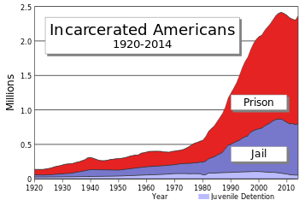
How to Build Partnerships with Parents, Community Resources and District Programs

Slide 15
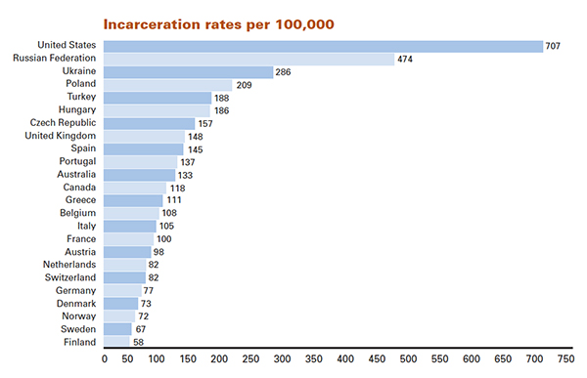
How does that compare to other countries?
How to Build Partnerships with Parents, Community Resources and District Programs

Slide 16
Students identified on the autism spectrum disorder.
In 2018 the CDC determined that approximately 1 in 59 children is diagnosed with an autism spectrum disorder (ASD).
1 in 37 boys
1 in 151 girls
How to Build Partnerships with Parents, Community Resources and District Programs

Slide 17
How has that changed...
How to Build Partnerships with Parents, Community Resources and District Programs

Slide 18
Students influenced by social media...
According to eMarketer.com, 5.7 million children under the age of 11 have accounts on Facebook, Instagram, and Snapchat.11 have accounts on Facebook, Instagram, a
How to Build Partnerships with Parents, Community Resources and District Programs

Slide 19
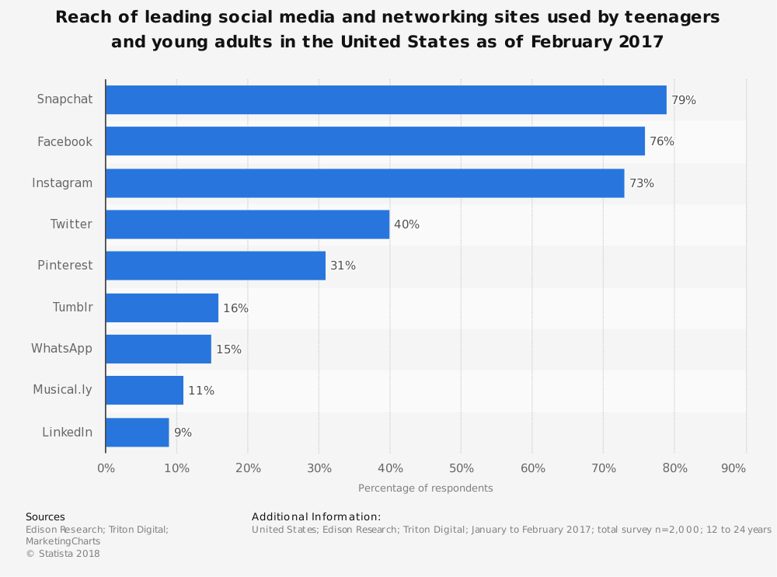
How to Build Partnerships with Parents, Community Resources and District Programs

Slide 20
Being able to prepare and present an interesting and challenging curriculum is hard enough, throw on top of that these other dynamics and it is easy to see why educating a child is not simple, but rather a complicated process.
How to Build Partnerships with Parents, Community Resources and District Programs

Slide 21
In reality, almost every other aspect of our world is also becoming more complicated each day.
Navigating through it is more difficult than ever and doing it alone is almost impossible.
Think of it in terms of relationships status…
How to Build Partnerships with Parents, Community Resources and District Programs

Slide 22
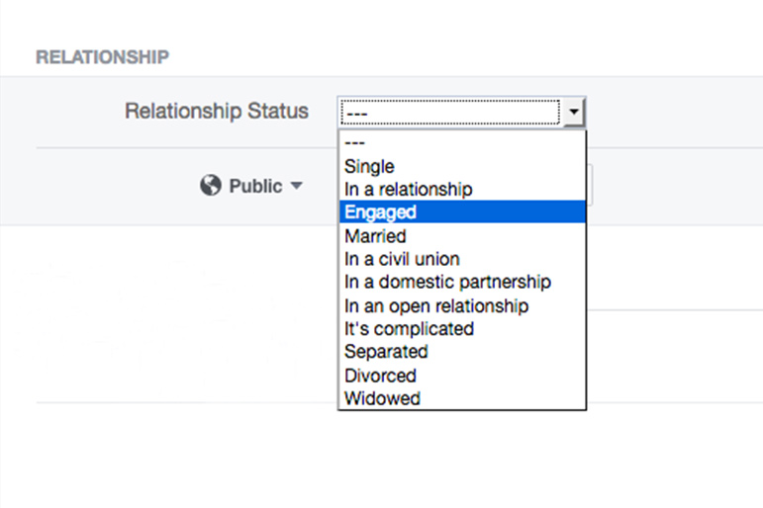
Facebook gives you 11 options. Including “It’s complicated”

Slide 23
Changes in technology have made life easier in many ways, but it also has made it more challenging.
Cyber bullying for example.
How to Build Partnerships with Parents, Community Resources and District Programs

Slide 24
How many of you in here today don’t have an account on one of the social media sites in the previous slide?
How many of you are on more than one of those sites?
11 have accounts on Facebook, Instagram
How to Build Partnerships with Parents, Community Resources and District Programs

Slide 25
So is the world being more complicated a good or bad thing…
Actually it really doesn’t matter, it just is more complicated.
How to Build Partnerships with Parents, Community Resources and District Programs

Slide 26
As we said earlier, the point is that the issues and challenges facing the students walking into your classroom today are much more complex than ever before.
It would be unrealistic to expect any individual teacher to have the knowledge and skills to address all of different these issues.
How to Build Partnerships with Parents, Community Resources and District Programs

Slide 27
As a teacher, you need to tap into the support, knowledge and skills of a variety of other individuals to address these issues and challenges.
They are far too complex for you to “go it alone” anymore.
How to Build Partnerships with Parents, Community Resources and District Programs

Slide 28
That’s is why we need to build and maintain partnerships with others. We need their help to ensure that our students are successful in our classrooms.
We also need them for our own sanity! You can drive yourself crazy attempting to be all things to all your students.
How to Build Partnerships with Parents, Community Resources and District Programs

Slide 29
Think of a challenge you might have in your life right now.
Let’s say it’s a health challenge.
You might need to partner with your Doctor, a nutritionist, a physical therapist and personal trainer.
How to Build Partnerships with Parents, Community Resources and District Programs

Slide 30
These different individuals can provide you with the specific knowledge and motivation to take the appropriate actions you need to address that health issue.
How to Build Partnerships with Parents, Community Resources and District Programs

Slide 31
You might even work with a acupuncturist or a hypnotherapy.
Joe used hypnotherapy to address his fear of heights.
Did it work?
How to Build Partnerships with Parents, Community Resources and District Programs

Slide 32
Somewhat…He’s not going on this roller coaster, but he can now stand next to a rail on a 4 story building and not freeze.
How to Build Partnerships with Parents, Community Resources and District Programs

Slide 33
The other aspect of partnering, is that sometimes these other individuals have a different value system.
You are communicating one thing to a student and a parent is communicating something else.
How to Build Partnerships with Parents, Community Resources and District Programs

Slide 34
How hard would it be to tell a student about the importance of investing time in their school work, and a parent is telling them they need to spend most of their time in the weight-room for football?
Joe teaches classes in the southeastern part of the state of Colorado. It is a very rural area.
How to Build Partnerships with Parents, Community Resources and District Programs

Slide 35
One of the high school teachers shared that a student said her parents thought she was wasting her time in school. She was going to be a farmer’s wife and needed to know about keeping a house, cooking, dressing chickens, raising livestock, etc. and didn’t need to know about literature and algebra.
How to Build Partnerships with Parents, Community Resources and District Programs

Slide 36
By forming partnerships with the different individuals and programs, you can find out what is being communicated to your students.
How to Build Partnerships with Parents, Community Resources and District Programs

Slide 37
COURSE
OBJECTIVES
How to Build Partnerships with Parents, Community Resources and District Programs

Slide 38
So, the objectives of this class are very simple:
Be able to identify the partnerships needed to help each of your students succeed.
Know how to both build and maintain those partnerships.
How to Build Partnerships with Parents, Community Resources and District Programs

Slide 39
-You will identify two students in your class. -Assess their needs in relationship to what they need to be successful in your classroom
-Determine what individuals, family, community resources or school and district programs you can partner with to have those students succeed
-Look at your present relationship with those individuals, groups, or organizations.
How to Build Partnerships with Parents, Community Resources and District Programs

Slide 40
-Take actions to either build your relationships with those individuals or what actions you need to take to maintain your relationships with them
-Evaluate the impact your actions had in promoting academic success for those two students
-Determine what actions you need to do in the future.
How to Build Partnerships with Parents, Community Resources and District Programs

Slide 41
IMPORTANT
INFORMATION
How to Build Partnerships with Parents, Community Resources and District Programs

Slide 42
Because of the DOE limiting us to 30 students per class, we can no longer provide you with credit for a future class if you are unable to complete the Portfolio.
We will do everything in our power to make sure you can complete the Portfolio. Communicate with us if you are having any problems.
How to Build Partnerships with Parents, Community Resources and District Programs

Slide 43
Since we are teaching two sections of the same class, if you are having a problem attending one of the monthly session Saturdays, you can attend the other.
How to Build Partnerships with Parents, Community Resources and District Programs

Slide 44
Section #1
June 17,18
Oct 19
Section #2 June 19, 30
Oct 26
How to Build Partnerships with Parents, Community Resources and District Programs

Slide 45
The PowerPoint used in the presentation today will be on Joe’s website:
JoeLoVerde.com
How to Build Partnerships with Parents, Community Resources and District Programs

Slide 46
The requirements for participants taking the class for DOE “PD” and those taking it for Brandman University credit are different.
DOE teachers need to complete a Portfolio.
Kamehameha teachers need to complete a Practicum.
How to Build Partnerships with Parents, Community Resources and District Programs

Slide 47
The different requirements and due date for the Practicum are listed on the back page of the Practicum.
How to Build Partnerships with Parents, Community Resources and District Programs

Slide 48
For those of you who would like a receipt for the class, one will be available for you to download from Joe’s website.
It is on Word, so type in your name and print off a copy. We will sign it for you at the April session.
How to Build Partnerships with Parents, Community Resources and District Programs

Slide 49
We DO NOT use the payment tab on the DOE website.
It will always show that you haven’t paid for the class. That is because we keep our own records. You have all obviously paid for the class prior to the beginning of this class. So disregard what it says on the payment tab.
How to Build Partnerships with Parents, Community Resources and District Programs

Slide 50
You are required to turn in your Portfolio or Practicum electronically. We do no accept hard copies.
Portfolios and practicums submitted electronically never get lost, are easier for us to read and easier for you to make any additions or corrections that the OCISS requests.
How to Build Partnerships with Parents, Community Resources and District Programs

Slide 51
The OCISS will review 10% of the Portfolios from this class. Based upon those Portfolios being acceptable, they will grant credit to everyone in the class.
Their standard for the Portfolios includes:
-Professional looking Portfolios
-No spelling errors
-Clear pictures of student work
How to Build Partnerships with Parents, Community Resources and District Programs

Slide 52
-Current student work that is easy to read
-No student names on the student evidence
-No frontal shots of student’s faces…side shots, backs of their heads or block out their faces
-Organized and all work and student evidence is in the proper sequence
How to Build Partnerships with Parents, Community Resources and District Programs

Slide 53
-The depth and quality of each answer. They are looking for detailed and reflective answers to each of the questions
We will provide you with more detail and examples about how to answer each question.
How to Build Partnerships with Parents, Community Resources and District Programs

Slide 54
Each of you must turn in a separate and unique Portfolio.
We know that you might be in here with a team member and you have the same students, unfortunately you can’t turn in one Portfolio.
How to Build Partnerships with Parents, Community Resources and District Programs

Slide 55
You also can’t use the same student evidence.
You must assess and apply the concepts to different students.
Kamehameha teachers can turn in a group Practicum.
How to Build Partnerships with Parents, Community Resources and District Programs

Slide 56
PARTNERSHIP
VS.
REALATIONSHIP
How to Build Partnerships with Parents, Community Resources and District Programs

Slide 57
The question comes up about the difference between a relationship and a partnership.
We don’t want to get hung up on the difference, but want you to know how we view the difference.
At times we may use these terms interchangeably so please be patient and grant us some grace.
How to Build Partnerships with Parents, Community Resources and District Programs

Slide 58
A relationship is where individuals are working together to create or maintain a connection with the other person or persons.
A partnership, is a type of relationship where the individuals move beyond a connection and try to achieve a common goal or objective.
How to Build Partnerships with Parents, Community Resources and District Programs

Slide 59
You can’t have a good partnership without good relationships with the other individuals working for the same goal or objective.
On the other hand, you may have a good relationship, but not a good partnership.
How to Build Partnerships with Parents, Community Resources and District Programs

Slide 60
You and your spouse, significant other, etc. get along great, but if you had to work together, you might want to kill one another.
Or you might partner well in doing projects around your home, but raising children is a whole different thing.
How to Build Partnerships with Parents, Community Resources and District Programs

Slide 61
5 FACTORS
PARTNERSHIPS
How to Build Partnerships with Parents, Community Resources and District Programs

Slide 62
Let’s take an in-depth look at partnerships.
How to Build Partnerships with Parents, Community Resources and District Programs

Slide 63
There basically five essential aspects of good partnerships.
Agreed upon common goal.
In partnerships, you can disagree on how to achieve the goal, but you have to have a common goal or objective.
How to Build Partnerships with Parents, Community Resources and District Programs

Slide 64
In your classroom, this is the success of the individual student.
What is a concern at times, is that the different partners, don’t have the same goal.
This can come from how we each define success in the classroom.
How to Build Partnerships with Parents, Community Resources and District Programs

Slide 65
Your goal may be to get the student to put more effort into their work and the parent’s goal is for them to have friends and feel good about themselves.
How to Build Partnerships with Parents, Community Resources and District Programs

Slide 66
This difference in goals came up many times for Joe when he was a Vice-Principal at an elementary school. An example…
A teacher was struggling with a student who was disrupting the learning of all the students in their class.
By disruption, we mean hitting other students and throwing chairs.
How to Build Partnerships with Parents, Community Resources and District Programs

Slide 67
Joe would suspend the child. Calling the parent and sending them home.
Joe’s goal was to provide the students with a safe learning environment and allow the teacher to focus on their lesson and not be putting so much energy into controlling the behavior of this one student.
How to Build Partnerships with Parents, Community Resources and District Programs

Slide 68
The district’s goal was to lower their rates of suspension. To be able to report that the behavior of their student population was improving and their were less discipline problems.
So their goals were not the same which caused significant friction between Joe and the district.
How to Build Partnerships with Parents, Community Resources and District Programs

Slide 69
It is difficult to work together when you don’t have the same goals.
Do you have examples of that at your school?
What about OCISS/State and you in regards to PD
How to Build Partnerships with Parents, Community Resources and District Programs

Slide 70
So one the first things to build and maintain a good partnership is making sure you do have that common goal.
If your goal is different than the other individual you need to partner with, it may be that you need to educate them about your goal, or they may need to educate you on why your goal may not be the highest priority for the student.
How to Build Partnerships with Parents, Community Resources and District Programs

Slide 71
Examples:
Joe had a parent who only sent her kindergarten student to school about 2 days a week.
She didn’t see the value in kindergarten in setting her child up for success in school.
How to Build Partnerships with Parents, Community Resources and District Programs

Slide 72
Before Joe could build a partnership with the parent, he had to educate her on the importance of setting her child up for success. That the skills the child was learning in kindergarten were essential for her having success in 1st grade.
How to Build Partnerships with Parents, Community Resources and District Programs

Slide 73
On the other hand, you may be frustrated with a student in your class who you know has tremendous potential, but is turning in poor quality work.
In partnering with the Parent, you may find out for example they are dealing with the other parent in jail, a divorce going on, medical issues the child or a family member is facing.
How to Build Partnerships with Parents, Community Resources and District Programs

Slide 74
In building the partnership, you became educated about an issue or challenge you didn’t know existed.
How to Build Partnerships with Parents, Community Resources and District Programs

Slide 75
This leads into the second essential aspect of good partnerships.
2. Communication…
It is essential that you have good two way communication for a partnership to work.
How to Build Partnerships with Parents, Community Resources and District Programs

Slide 76
Something as simple as a parent sending you a text, email or even talking to you in person before school starts and letting you know that the student had a rough morning at home, had just gotten some bad news, suffered a loss, etc.
How to Build Partnerships with Parents, Community Resources and District Programs

Slide 77
That information allows you to be proactive in addressing that student’s need that day.
Helping them and possibly preventing a melt down or other type of disruption that negatively impacts your ability to teach that day.
How to Build Partnerships with Parents, Community Resources and District Programs

Slide 78
That type of communication only occurs when you have partnered with the parent and established a good relationship.
How to Build Partnerships with Parents, Community Resources and District Programs

Slide 79
When in doubt, over communicate.
People might get frustrated with you with too much communication, but no where near as frustrated as they would be if you didn’t communicate enough.
How to Build Partnerships with Parents, Community Resources and District Programs

Slide 80
Think of it this way…
How many of you appreciate that “reminder” call, email or text you get from your Doctor, Dentist, Eye Doctor, hairdresser, etc. about an upcoming appointment?
How to Build Partnerships with Parents, Community Resources and District Programs

Slide 81
We all have so much on your plates, it is easy to let something slip by. So that communication can be the difference between you remembering and forgetting that appointment.
How to Build Partnerships with Parents, Community Resources and District Programs

Slide 82
This communication is also important with community resources and district programs.
Building those partnerships on the front end.
Don’t be the individual who only calls when they want something.
How to Build Partnerships with Parents, Community Resources and District Programs

Slide 83
We can almost guarantee that you all have at least one of those people in your life that you only hear from when they want something from you.
They usually start out the conversation asking about how you’re doing and sometimes you get sucked into thinking they just called to catch up on things.
How to Build Partnerships with Parents, Community Resources and District Programs

Slide 84
But the “Ask” always comes.
You find out the true reason for their call.
DON’T BE THAT PERSON!
Build that relationship before you need to ask for the favor.
How to Build Partnerships with Parents, Community Resources and District Programs

Slide 85
Another way to look at it is, what have you done for them that they would want to do something for you?
Are you one of those people who owes people favors, or someone who is owed favors from others?
How to Build Partnerships with Parents, Community Resources and District Programs

Slide 86
Get out your phones.
Look at recent text and email exchanges you’ve had with friends.
Who initiated those exchanges? Did you ask for something? Did they ask you for something?
How to Build Partnerships with Parents, Community Resources and District Programs

Slide 87
How many of those communications were just checking in with the other person.
You may not be a person who texts or emails, so how many people did you call? Or were most of the calls initiated by the other person?
How to Build Partnerships with Parents, Community Resources and District Programs

Slide 88
3. Trust…you believe the other person is honest with you. That they say what they mean and will do what they say.
Trust is one of those things that is very hard to earn and very easy to lose.
How to Build Partnerships with Parents, Community Resources and District Programs

Slide 89
Joe and I are horrible with money and keeping accurate records.
What is most important though is that we both know mistakes are often made with absolutely NO intention of cheating the other person.
We have total trust in each other.
How to Build Partnerships with Parents, Community Resources and District Programs

Slide 90
One concept to keep in mind when dealing with individuals that you are partnering with related to trust, is to under promise and over deliver.
What we mean by that is never over promise something.
Example:
How to Build Partnerships with Parents, Community Resources and District Programs

Slide 91
If a parent has a question for you that you can’t answer immediately and you have to research, give yourself ample time to get back with them.
If you think it will take you a day, tell them you’ll get them an answer in two days.
How to Build Partnerships with Parents, Community Resources and District Programs

Slide 92
When you come back with an answer in one day, you look like an all-star.
If you say you can give them an answer in one day and something comes up and it takes you two, you underdelivered.
How to Build Partnerships with Parents, Community Resources and District Programs

Slide 93
You all are very busy and new things come up all the time, give yourself some leeway.
Think how frustrated you get when someone says I’ll call you on Monday and Monday comes and goes and you didn’t hear from them.
How to Build Partnerships with Parents, Community Resources and District Programs

Slide 94
If someone emails you with a question and you don’t know the answer off the top of your head, email them back acknowledging you received their email, are going to get them an answer and when you will be getting them that answer.
This action also addresses the 4th factor, having the other person feel valued.
How to Build Partnerships with Parents, Community Resources and District Programs

Slide 95
4. Valued…
Each of us wants to feel valued in a partnership. That what you are contributing is important and needed for the accomplishment of the common goal.
Getting back with someone quickly makes them feel valued.
How to Build Partnerships with Parents, Community Resources and District Programs

Slide 96
How do we feel valued?
-A thank you or other type of appreciation
-Checking in with us to see how we are doing
-Being listened to…when in conversation, you truly feel the other person “heard” what you had to say
-Get to know them personally…ask about how they are, how their life is going, interests
How to Build Partnerships with Parents, Community Resources and District Programs

Slide 97
-You let them vent without making judgements
-Respect their opinions and ideas
-Appreciate what they bring to the situation
-Be open about yourself
How to Build Partnerships with Parents, Community Resources and District Programs

Slide 98
5. Understanding your role in the partnership.
In every partnership, each member of that partnership has a role to play.
-Leadership
-Support
-Expertise
How to Build Partnerships with Parents, Community Resources and District Programs

Slide 99
You might have been in a partnership where a couple of individuals thought they were the leader.
This can result in some interesting arguments and nothing getting done.
Clarity about each individual’s role and contribution is essential.
How to Build Partnerships with Parents, Community Resources and District Programs

Slide 100
One of the hardest things to do, is to allow another to be the leader in a partnership.
They may not do things the “WAY” you think they should be done. You sometimes have to accept that there may be other ways of accomplishing the same goal or objective.
How to Build Partnerships with Parents, Community Resources and District Programs

Slide 101
My partnership with Joe in the classes is an example of this…
Roles
Responsibilities
Direction
How to Build Partnerships with Parents, Community Resources and District Programs

Slide 102
Joe and I work together on coming up with ideas for our next class.
Joe writes it up, shares it with me and then we send it on for approval.
Joe creates the PowerPoints and sends them to me.
How to Build Partnerships with Parents, Community Resources and District Programs

Slide 103
I go over them making changes that I deem necessary.
As Joe always tells me, you’re in front of the group and have a better idea of what is needed than he does sitting in his office in Denver. He trusts me since we are both on the same page related to what we want to accomplish.
How to Build Partnerships with Parents, Community Resources and District Programs

Slide 104
Look at a relationship you presently have with another individual. It can be any partnership, personal or professional.
If you are struggling with picking someone, just use your Principal.
Now look at the 5 essential aspects of good partnerships.
How to Build Partnerships with Parents, Community Resources and District Programs

Slide 105
Do you have a common goal or objective?
Do you have good communication?
Do you trust the other person?
Do you feel valued by them?
Do you know your role in the relationship?
How to Build Partnerships with Parents, Community Resources and District Programs

Slide 106
BUIDLING
VS
MAINAINING
How to Build Partnerships with Parents, Community Resources and District Programs

Slide 107
While building and maintaining relationships are different, many of the actions you might take apply to both.
Reaching out for example.
You might reach out to your parents with a phone call, text, email, etc. This action can be part of building a relationship or maintaining it.
How to Build Partnerships with Parents, Community Resources and District Programs

Slide 108
Don’t get hung up on the difference when you are considering what actions to take.
But know that there are differences we see when you are building or maintaining a relationship.
How to Build Partnerships with Parents, Community Resources and District Programs

Slide 109
Building partnership involves:
-Reaching out to the different individuals
-Finding common ground
-Establishing your credibility
How to Build Partnerships with Parents, Community Resources and District Programs

Slide 110
Reaching out…
What have you done this year to “reach out” to the Parent of your students?
-Phone calls
-Texts
-Newsletters
How to Build Partnerships with Parents, Community Resources and District Programs

Slide 111
-Weekly updates or progress reports
-Curriculum, homework, etc. posted on your webpage
-Events such as back to school night, assembly, other programs
-Etc.
At your tables share how you and your school reaches out to parents.
How to Build Partnerships with Parents, Community Resources and District Programs

Slide 112
One of the important strategies in building relationships is:
-Finding common ground…
How many times have you heard…”Oh, you graduate from Farrington HS in 2009, did you know …..?
How to Build Partnerships with Parents, Community Resources and District Programs

Slide 113
We build relationships by finding those things we have in common.
The old line, “We like people who are like us,” is very true.
You may have some friends who you don’t have much in common with today, but at one time, when the friendship formed, you may have.
How to Build Partnerships with Parents, Community Resources and District Programs

Slide 114
Establishing credibility.
Letting the other person know…
-You want to work together
-You can be trusted
-You’ll do what you say you’ll do
-You value them and what they can contribute
How to Build Partnerships with Parents, Community Resources and District Programs

Slide 115
Relationship are always in a constant state of flux.
They tend to be growing closer or farther apart. Very few are static.
You have to work at them.
How to Build Partnerships with Parents, Community Resources and District Programs

Slide 116
NEEDS
ASSESSMENT
How to Build Partnerships with Parents, Community Resources and District Programs

Slide 117
Please look at page 2 of your Portfolio/Practicum.
Needs Assessment
How to Build Partnerships with Parents, Community Resources and District Programs

Slide 118
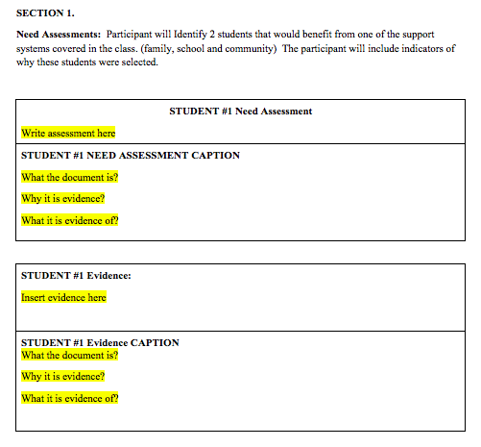

Slide 119
We are asking that you identify two students whose academic success in your classroom would be helped by you partnering with their parents, community resources or district programs.
Use only first names of these students or simply call them student “A” and student “B.”
How to Build Partnerships with Parents, Community Resources and District Programs

Slide 120
The answer to this question will involve.
1. Identifying who you picked
2. Why you picked them (need)
3. Who are the individuals that you could partner with that would have the most impact upon that student’s success (Their influencers or individuals with expertise)
How to Build Partnerships with Parents, Community Resources and District Programs

Slide 121
4. What can they contribute to the partnership in helping the students succeed.
How to Build Partnerships with Parents, Community Resources and District Programs

Slide 122
In identifying their needs, you are to provide student evidence that documents their need related to their level of academic achievement or one of the district’s GLO’s.
So… you could provide
-Formative test scores, homework, essays etc.
-Examples of their work (Quality producer)
-Problem solving (Complex thinker)
How to Build Partnerships with Parents, Community Resources and District Programs

Slide 123
-Interactions with Peers…included in groups, engagement with peers (Effective Communicator)
-Ability to work with groups (Community Contributor)
-Attendance, turning in work, behavior in the classroom (Self-directed learner)
How to Build Partnerships with Parents, Community Resources and District Programs

Slide 124
You will fill out a Caption for this piece of evidence.
This will establish a baseline that will allow you to determine the impact your actions had on student performance.
How to Build Partnerships with Parents, Community Resources and District Programs

Slide 125
You will also need to fill out a caption for your entire answer to question #1.
How to Build Partnerships with Parents, Community Resources and District Programs

Slide 126
INFLUENCERS
How to Build Partnerships with Parents, Community Resources and District Programs

Slide 127
So what do we mean by “Influencers:
These are people who impact and shape how we think, what we believe, how we act, how we dress, etc.
How to Build Partnerships with Parents, Community Resources and District Programs

Slide 128
A quick quiz.
Who is…
Huda Kattan
Cameron Dallas
Michelle Lewin
Chiara Ferragni
How to Build Partnerships with Parents, Community Resources and District Programs

Slide 129
These are the top 4 individuals in terms of followers on Instragram.
Huda Kattan 23.8 million followers
Cameron Dallas 19.8 million followers
Michelle Lewin 12.2 million followers
Chiara Ferragni 9.7 million followers
How to Build Partnerships with Parents, Community Resources and District Programs

Slide 130
I don’t know any these individuals, they aren’t influencing how I see the world, but they are influencing millions of their followers on Instagram.
How to Build Partnerships with Parents, Community Resources and District Programs

Slide 131
Who has the most Twitter followers?
Top 5
Katy Perry
Justin Bieber.
Barack Obama
Rihanna
Taylor Swift
How to Build Partnerships with Parents, Community Resources and District Programs

Slide 132
Before we become too judgmental, we all have people that influence our lives.
It might be a radio personality…
It is estimated the Rush has 15.5
million people who listen to his
show weekly.
show has been the number one commercial talk show since at least 1987 when record keeping bega
How to Build Partnerships with Parents, Community Resources and District Programs

Slide 133
It might be a TV personality.
How to Build Partnerships with Parents, Community Resources and District Programs

Slide 134
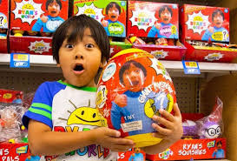
Do you know who this is?
How to Build Partnerships with Parents, Community Resources and District Programs

Slide 135
According to Forbes' magazine, in 2016-2017 Ryan was the 8th highest paid YouTube entrepreneur, having brought in $11 million in revenue between 2016 and 2017. In 2018 he was listed as the highest paid YouTuber bringing in $22m of revenue from his videos and his product line at Walmart.
How to Build Partnerships with Parents, Community Resources and District Programs

Slide 136
What does Ryan do?
He plays with toys and simply reviews them.
How to Build Partnerships with Parents, Community Resources and District Programs

Slide 137
Advertisers know the power of influencers.
Think of all the celebrities and athletes that promote products.
One of the most blatant ones is with Matthew McConaughey.
How to Build Partnerships with Parents, Community Resources and District Programs

Slide 138
In his commercials for Lincoln cars, not once do they mention the name of the car, how dependable it is, how affordable it is, how fast it can go, etc.
Really nothing about the vehicle other than Matthew McConaughey drives one.
How to Build Partnerships with Parents, Community Resources and District Programs

Slide 139
We all have people whose opinion we value more than others.
Who are those influencers in your life?
You might have different influencers…
-Work
-Relationship
-Spiritual
How to Build Partnerships with Parents, Community Resources and District Programs

Slide 140
It could be your…
-Pastor/Priest
-Neighbor
-Principal
-Co-worker
-Political leader
-Social advocate
How to Build Partnerships with Parents, Community Resources and District Programs

Slide 141
What we are looking for with our students, is knowing who those influencers are in their lives.
Working with those influencers can have a tremendous impact on how the student performs in our classroom.
How to Build Partnerships with Parents, Community Resources and District Programs

Slide 142
Who were the influencers in your life growing up?
-Celebrities
-Athletes
-Parents
-Community members
How to Build Partnerships with Parents, Community Resources and District Programs

Slide 143
For our students it could be…
Parents
Parent influence is strongest when they are young…beginning in middle school it goes down with peer influence becoming stronger.
How to Build Partnerships with Parents, Community Resources and District Programs

Slide 144
Community…
We include in community, other members of the school staff as well as individuals outside of the school.
So it could be…
How to Build Partnerships with Parents, Community Resources and District Programs

Slide 145
-Former teachers
-Counselors
-Custodian
-Church youth leaders
-Coaches
-Grandparents
-Sports figures
-Etc.
How to Build Partnerships with Parents, Community Resources and District Programs

Slide 146
How do you find out who those influencers are for your students?
ASK…
-Them
-Their parents
-Watch what they wear, read, listen to, talk about etc.
How to Build Partnerships with Parents, Community Resources and District Programs

Slide 147
In addition to people who can influence our lives, there are individuals and groups with specific knowledge and skills that can positively impact our lives.
This is where community resources and district programs come into play.
How to Build Partnerships with Parents, Community Resources and District Programs

Slide 148
As a teacher, it is unrealistic to think we can be all things to all our students. Their needs are just too complicated for that.
So we need to partner with those individuals who have the knowledge, skills and expertise that we don’t possess.
How to Build Partnerships with Parents, Community Resources and District Programs

Slide 149
How do you find out about them.
ASK…
-People in your building
-Look at community resources online
-Contact your district
How to Build Partnerships with Parents, Community Resources and District Programs

Slide 150
A message coming from an “influencer” can have a incredible impact upon a student’s behavior and ultimately their success in your classroom.
How to Build Partnerships with Parents, Community Resources and District Programs

Slide 151
WRITTEN REFLECTION
How to Build Partnerships with Parents, Community Resources and District Programs

Slide 152
Turn to page #3 of your Portfolio/Practicum.
How to Build Partnerships with Parents, Community Resources and District Programs

Slide 153
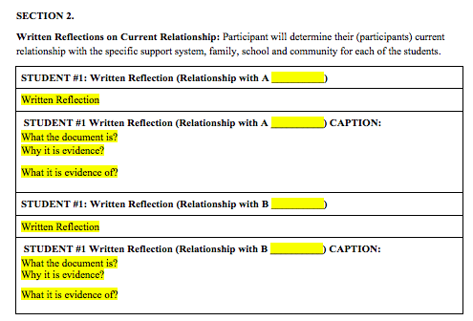

Slide 154
For this part, you will determine the present relationship you have with the individuals you believe have the greatest influence on the two students you selected.
Strong? Weak? How often do you communicate? Etc.
How to Build Partnerships with Parents, Community Resources and District Programs

Slide 155
Answering this question tells you what you need to do.
Do I need to take actions to build a relationship?
Do I need to take action to maintain this relationship and keep it strong?
How to Build Partnerships with Parents, Community Resources and District Programs

Slide 156
Take some time with this question and be honest with yourself.
If you haven’t been doing what you need to to have a good relationship with a certain individual, don’t feel bad about it, DO SOMETHING ABOUT IT.
How to Build Partnerships with Parents, Community Resources and District Programs

Slide 157
The more successful your students are, the more successful you feel about yourself.
If they are engaged in learning, they are not causing problems in the classroom and you can focus on what you enjoy doing…TEACHING.
How to Build Partnerships with Parents, Community Resources and District Programs

Slide 158
You will also need to fill out a caption for this question.
How to Build Partnerships with Parents, Community Resources and District Programs

Slide 159
ACTION PLAN
How to Build Partnerships with Parents, Community Resources and District Programs

Slide 160
Turn to page #4 of your Portfolio/Practicum.
How to Build Partnerships with Parents, Community Resources and District Programs

Slide 161
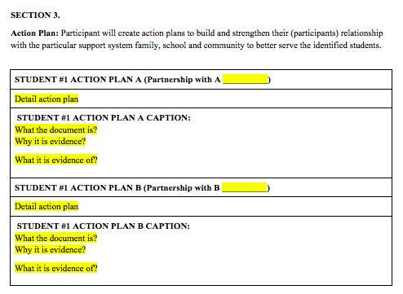

Slide 162
Based upon your answer to Part 1, you know which individuals (influencers or people with expertise) you are going to partner with to have your students succeed.
In Part 2, you determined the strength or weakness of those relationships.
How to Build Partnerships with Parents, Community Resources and District Programs

Slide 163
Here is where we want you to come up with specific actions you are going to take to ensure that the partnerships you form with these individuals or support group benefits your students.
We want you to come up with at least two actions for each student.
How to Build Partnerships with Parents, Community Resources and District Programs

Slide 164
Your actions will be quite diverse as each situation will be unique.
We will talk about some general things you can do, but you need to come up with your specific actions on your own.
How to Build Partnerships with Parents, Community Resources and District Programs

Slide 165
Communication…
We’ve talked some about this, but let’s go more in-depth.
How will you communicate with the parent, community resource or district program?
How to Build Partnerships with Parents, Community Resources and District Programs

Slide 166
The first question to answer…
What is your strength in communication?
-One on one
-Email
-Phone
-Text
-Letter
-Group presentation
How to Build Partnerships with Parents, Community Resources and District Programs

Slide 167
We all have strengths and weaknesses in our communication skills.
Determine your strength and use that as much as possible in your communications.
People whose strength is not the written word.
How to Build Partnerships with Parents, Community Resources and District Programs

Slide 168
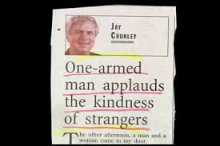
How to Build Partnerships with Parents, Community Resources and District Programs

Slide 169
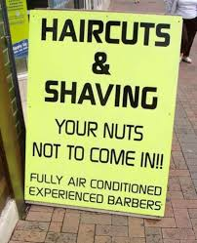
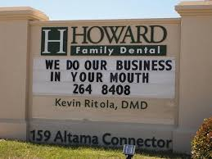
How to Build Partnerships with Parents, Community Resources and District Programs

Slide 170
The second aspect of communication is finding out what type of communication the other person prefers.
Working with Joe, we do best when we talk by phone. His strength is not in email and we can get things figured out so much faster when we call one another.
How to Build Partnerships with Parents, Community Resources and District Programs

Slide 171
You will find if you email him, he will answer your question and tell you if you still aren’t clear about his answer that you should call him.
Again, it all depends on your strengths and what works best for the individual you are communicating with.
How to Build Partnerships with Parents, Community Resources and District Programs

Slide 172
Clarity is the next component of any action you take.
Be clear about why you are needing their help, identifying the outcome and why it is important. How you think they can help and how you will be communicating with them (when & how often). Always error on the side of over communication.
How to Build Partnerships with Parents, Community Resources and District Programs

Slide 173
Clarity also involves finding out what the legal and ethical limits are for you and the individuals you are partnering with in relationship to any action you might take.
Be careful not to take actions or ask them to take actions that might put them in any type of jeopardy.
How to Build Partnerships with Parents, Community Resources and District Programs

Slide 174
If you have any questions, please contact Joe at:
JoeLoVerde@me.com
Or call him at 303-718-3502
How to Build Partnerships with Parents, Community Resources and District Programs

