Slide 1
WELCOME
Deconstructing Standards/Objectives:
How to Create Learning Targets
DOE # IS 185559
DECONSTRUCTING STANDARDS

Slide 2
Before we begin, we’d like to take a moment to thank you all for your support of our classes.
We know that taking a class in this format may not be your first choice as you may be Zoomed or Webexed out by now using it everyday with your own students.
It is certainly not our first choice.
DECONSTRUCTING STANDARDS

Slide 3
But given the current restrictions, we feel it is the safest way to protect your health and the health of those you love as well as being responsible to entire society.
So again, mahalo for your patience as we are still in the learning process of presenting our classes remotely.
DECONSTRUCTING STANDARDS

Slide 4
We have the class broken down into two parts.
Today we will cover the concept of deconstructing a standard, how to do it and how to create learning targets for that standard.
Tomorrow we will go over creating lessons to meet those learning targets and the requirements of the Portfolio.
DECONSTRUCTING STANDARDS

Slide 5
Someone emailed us asking if the session today and tomorrow would last the full 8 hours we have scheduled on the course outline for each day.
The answer to that is NO!
If we attempted to keep you for that long of time, we would be afraid you would end up wanting to harm yourself or us!
DECONSTRUCTING STANDARDS

Slide 6
So, we will be going through the information rather quickly.
We will leave time at the end to answer questions and you can always email us at any time with a question or seeking a point of clarification.
This session will be recorded and posted on our website: LoVerdeGroup.com for you to download and review.
DECONSTRUCTING STANDARDS

Slide 7
Let’s start out getting your minds engaged.
You are to solve the value of the red shape in each sequence when the numbers are added together.
DECONSTRUCTING STANDARDS

Slide 8
.
DECONSTRUCTING STANDARDS

Slide 9
Submit your answer on the “Chat” feature.
DECONSTRUCTING STANDARDS

Slide 10
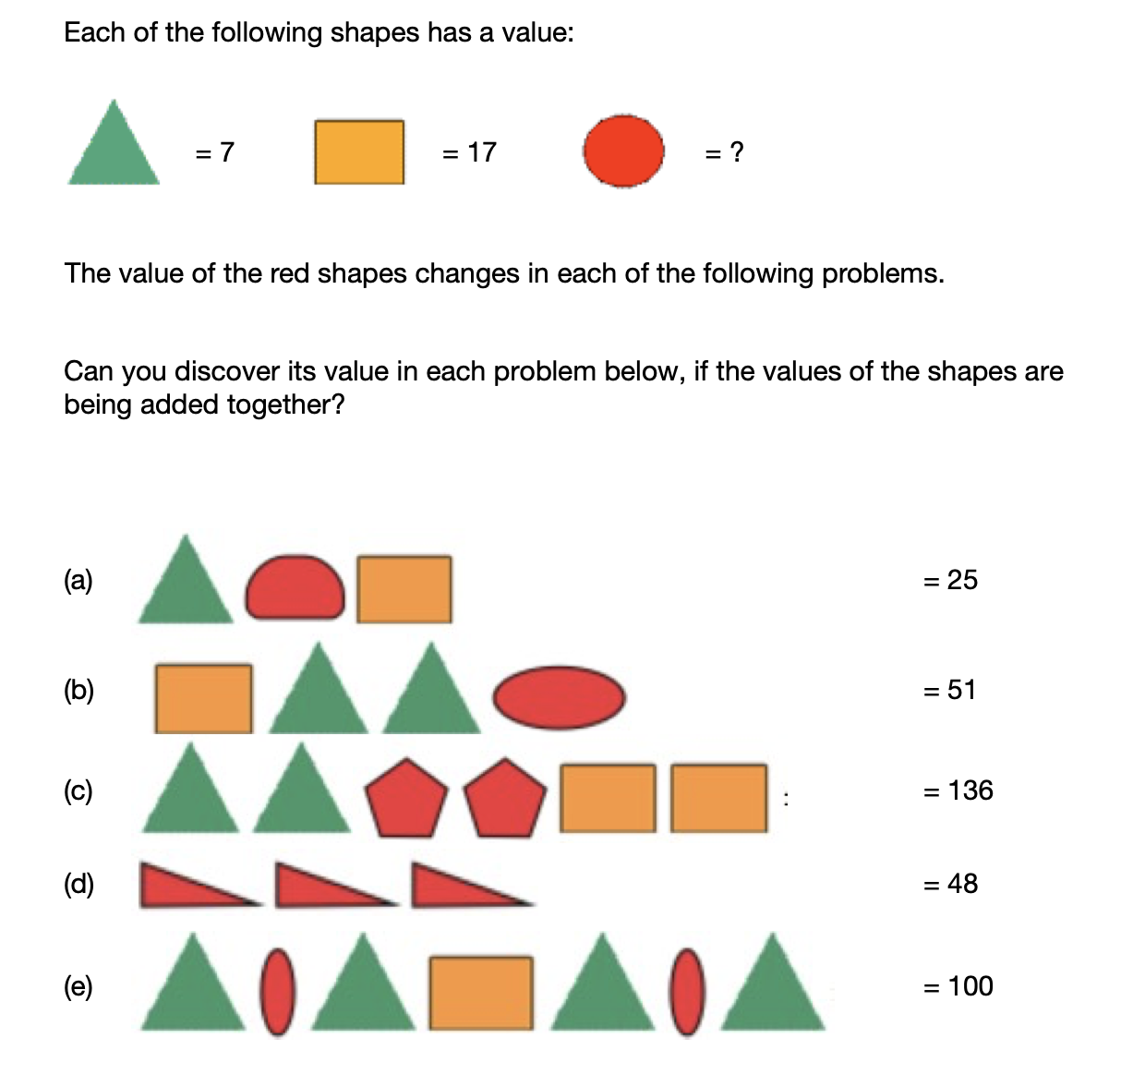
DECONSTRUCTING STANDARDS

Slide 11
What is the value of the red shape in each sequence.
A=
B=
C=
D=
E=
DECONSTRUCTING STANDARDS

Slide 12
A= 1
B= 20
C= 43
D= 16
E= 27.5
DECONSTRUCTING STANDARDS

Slide 13
Deconstructing standards is very similar to how you approach any problem.
All problems can seem overwhelming at first.
But, if you break it down in understandable parts and then begin addressing each of those parts, the problem can be solved or the challenged accomplished.
DECONSTRUCTING STANDARDS

Slide 14
Have any of you ever planned a surprise party for someone?
It can sound like a great idea until you begin to plan it and then it can seem overwhelming.
So how do you break it down…
DECONSTRUCTING STANDARDS

Slide 15
-When to have it? Day/time
-Where? Location, where to hide people/cars
-How are you going to get the birthday person there? What pretense are you going to use to get them to the location?
-Who to invite? How many people? Call or email each of them?
-Food and refreshments? How much, who pays for it,
-Gifts for the birthday person?
DECONSTRUCTING STANDARDS

Slide 16

A question you might add…
DECONSTRUCTING STANDARDS

Slide 17
Does the person being surprised carry a gun?
DECONSTRUCTING STANDARDS

Slide 18
These are all tasks that need to be accomplished for the party to be successful.
The same is true for the accomplishment of a standard.
Identifiable tasks are the same as learning targets achieved.
DECONSTRUCTING STANDARDS

Slide 19
In our view, many of the Common Core as well as other district standards can be a bit vague.
Here is one Common Core Standard for 10th grade English.
“Cite strong and thorough textual evidence to support analysis of what the text says explicitly as well as inferences drawn from the text” (Common Core RL10.1).
DECONSTRUCTING STANDARDS

Slide 20
We’re confident that almost all 10th graders would be able to decipher what that standard is asking them to do.
DECONSTRUCTING STANDARDS

Slide 21
The process of breaking it down into specific learning targets helps both the student and the teacher.
The student: It provides them with a clear and identifiable goal/target/objective.
There is no guessing about what I am expected to know, think about, do or create.
DECONSTRUCTING STANDARDS

Slide 22
The teacher:
It breaks down into specific skills what the students need to achieve the standard.
This allows the teacher to assess what specific knowledge, reasoning or skills the student might be lacking that is preventing them from achieving the standard.
DECONSTRUCTING STANDARDS

Slide 23
So the goal of this class is very simple.
We are going to teach you a process of deconstructing a standard, breaking it into specific learning targets.
Then how to create lessons that address those specific learning targets.
DECONSTRUCTING STANDARDS

Slide 24
Before we go any further, let’s go over some important information.
Given this class is being presented remotely, we’ve had to make a couple of changes.
DECONSTRUCTING STANDARDS

Slide 25
We have broken the class into two sections.
Today we will be going over why it is important to deconstruct a standard and how to create learning targets for a standard.
Tomorrow we will go over the Portfolio requirements.
DECONSTRUCTING STANDARDS

Slide 26
The PowerPoint used both days will be on our website:
loverdegroup.com
DECONSTRUCTING STANDARDS

Slide 27
You are required to turn in your Portfolio electronically. We do no accept hard copies.
Portfolios and practicums submitted electronically never get lost, are easier for us to read and easier for you to make any additions or corrections that the OCISS requests.
DECONSTRUCTING STANDARDS

Slide 28
The OCISS will review 10% of the Portfolios from this class. Based upon those Portfolios being acceptable, they will grant credit to everyone in the class.
We will be sending out the criteria that the OCISS office has shared with us about the specific criteria they are using to evaluate each Portfolio.
DECONSTRUCTING STANDARDS

Slide 29
Participants can work together on their Portfolios, but can’t use the same student evidence.
They must assess and apply the concepts to different students.
DECONSTRUCTING STANDARDS

Slide 30
Let’s get started.
We will be using the term “deconstructing” standards in this class.
You may have also heard the terms, “unpacking” a standard or “unwarping” a standard.
They mean the same thing.
DECONSTRUCTING STANDARDS

Slide 31
We are going to show you ONE way to deconstruct standards.
Understand there is no single or correct process for deconstructing a standard.
We encourage you to look at other processes of deconstructing a standard.
DECONSTRUCTING STANDARDS

Slide 32
Or modify the process the we will be using in this class.
What is important, is that you find a process that works for you.
Meaning, one that applies to the standards you are using and is easy for you to do.
DECONSTRUCTING STANDARDS

Slide 33
If it is easy and makes sense, you’ll use it!
If it is difficult and too time consuming, you won’t.
Deconstructing standards is important, so find a process that works for you.
DECONSTRUCTING STANDARDS

Slide 34
Step 1:
Look at the individual words in the standard and put them in one of four learning targets categories.
We are using 4 different learning target categories.
Again, some processes break the standard down even farther and some less.
DECONSTRUCTING STANDARDS

Slide 35
Here are the four categories of learning targets we will be using.
Knowledge targets
Reasoning targets
Skills targets
Product targets
DECONSTRUCTING STANDARDS

Slide 36
1.Knowledge targets.
This is the factual information, procedural knowledge, and conceptual understanding that the student must possess in order to achieve the standard.
Question to ask yourself: What must the student know to master this indicator?
DECONSTRUCTING STANDARDS

Slide 37
This includes the ability to:
-Identify
-Explain
-List
-Recall
-Recognize
-Name
-Recite
-Label
-Describe
-Define
DECONSTRUCTING STANDARDS

Slide 38
If the standard involved the ability to drive an automobile, you would need to “KNOW” the following.
What do the following shapes of these 4 different road signs mean?
DECONSTRUCTING STANDARDS

Slide 39
Upside down triangle?
Vertical rectangle?
Octagon?
Circle?
DECONSTRUCTING STANDARDS

Slide 40
In the chat feature, write in what the “Circle” sign indicates.
We’ll see how many of you can get this one right.
DECONSTRUCTING STANDARDS

Slide 41
Upside down triangle– This black, white and red sign means yield and to use caution. If you see this shape slow down and look out for possible obstacles.
Vertical rectangle-Signs of this shape most often communicate speed limits and parking regulations
DECONSTRUCTING STANDARDS

Slide 42
3. Octagon– The shape for stop. Keep an eye out for this shape to avoid driving when you aren’t supposed to be.
4. Circle- A circle means the presence of railroad tracks. Watch for trains and be ready for the uneven surface of crossing the tracks.
DECONSTRUCTING STANDARDS

Slide 43
DECONSTRUCTING STANDARDS

Slide 44
Okay, maybe not the fairest question given there aren’t any railroad crossing in Hawaii.
DECONSTRUCTING STANDARDS

Slide 45
2. Reasoning targets.
Identifies the reasoning skills that are needed to achieve the standard.
These are the specific thought processes and thinking skills needed to achieve the standard.
Question to ask yourself: How are students using the knowledge to solve a problem, make a decision, make a plan, etc.?
DECONSTRUCTING STANDARDS

Slide 46
They include the ability to:
-Summarize
-Evaluate
-Compare
-Contrast
-Explain
-Discuss
-Determine
-Judge
-Conclude
DECONSTRUCTING STANDARDS

Slide 47
These do not include all the reasoning skills.
Depending upon the standard, you may be asking your students to use other reasoning skills.
Back to our example of driving a car.
A reasoning skill would involve judging how fast you should be going when making a turn.
DECONSTRUCTING STANDARDS

Slide 48
3. Skills targets:
These targets are where a demonstration or a physical skill-based performance is part of the standard.
Skills targets are used more in performing arts, PE and foreign languages and in other subject areas.
Question to ask yourself: How are the students using knowledge and reasoning to perform a task? What must they be able to do?
DECONSTRUCTING STANDARDS

Slide 49
-Throw a ball
-Sing a song
-Speak another language
-Count
-Climb a rope
-Carry on a conversation
-Use appropriate manners
-Role play
-Act
DECONSTRUCTING STANDARDS

Slide 50
Our car example again.
Physically steering the car correctly.
Knowledge wise, you could name all the parts on steering column in a car.
Reasoning wise, you could explain and discuss the difference between power and regular steering in a car.
DECONSTRUCTING STANDARDS

Slide 51
But, can you steer the car?
Knowing when to release the wheel after a turn?
How far you need to turn the wheel to maintain your position in a lane?
DECONSTRUCTING STANDARDS

Slide 52
But, can you steer the car?
Knowing when to release the wheel after a turn?
How far you need to turn the wheel to maintain your position in a lane?
DECONSTRUCTING STANDARDS

Slide 53
A lost skill, driving a manual transmission.
DECONSTRUCTING STANDARDS

Slide 54
Only 18% of all Americans can drive a manual transmission.
The percentage of millennials who can drive a manual transmission is even less.
DECONSTRUCTING STANDARDS

Slide 55
4. Product:
These learning targets are the physical evidence created to show the achievement of a standard.
There are the tangible products that demonstrate the student’s understanding of the requirements in the standard.
Question to ask yourself: What are students asked to produce or create?
DECONSTRUCTING STANDARDS

Slide 56
-Essay/journal
-Video
-Chart, poster, model
-Demonstration
-Creating a computer program
-Audio recording
-A commercial
-Skit or play
-A game
DECONSTRUCTING STANDARDS

Slide 57
Let’s look at a Common Core standard for 6th grade math.
DECONSTRUCTING STANDARDS

Slide 58
CCSS.MATH.CONTENT.6.NS.C.5
Understand that positive and negative numbers are used together to describe quantities having opposite directions or values (e.g., temperature above/below zero, elevation above/below sea level, credits/debits, positive/negative electric charge); use positive and negative numbers to represent quantities in real-world contexts, explaining the meaning of 0 in each situation.
DECONSTRUCTING STANDARDS

Slide 59
1. Knowledge…what must the student know to even begin the achieve this standard?
-Positive and negative numbers
-Above and below
-Temperature
-Elevation/Sea levels
-Debits/credits
-Others you might identify
DECONSTRUCTING STANDARDS

Slide 60
2. Reasoning…what thinking skills are required for the student to possess to achieve this standard.
-Understand
-Describe
-Represent
-Explain
DECONSTRUCTING STANDARDS

Slide 61
3. Skills…what skills are required for the student to achieve this standard.
Not applicable in this standard.
DECONSTRUCTING STANDARDS

Slide 62
4. Performance…what must the student create to demonstrate their understanding of the standard.
-Real world examples of positive and negative quantities.
-Written explanation of what 0 means in those real world examples
DECONSTRUCTING STANDARDS

Slide 63
As we said before, deconstructing standards is not an exact science.
In going over the previous example, you might have looked at it differently than we did.
That’s okay!!!!
DECONSTRUCTING STANDARDS

Slide 64
The important point is that you are breaking the standard down into specific knowledge targets and reasoning targets for the student and it allows you to be clear on the what knowledge and reasoning skills you need to teach your students.
DECONSTRUCTING STANDARDS

Slide 65
Your homework for this afternoon.
DECONSTRUCTING STANDARDS

Slide 66
Look at section #1 in your Portfolio.
DECONSTRUCTING STANDARDS

Slide 67
SECTION 1.
Need Assessment Rationale: Participants will choose 2 standards/objectives to deconstruct from the following, Hawaii Common Core Standards, New Generation Science Standards, CSTA K-12 Computer Science Standards, Hawaii Content and Performance Standards III, Hawaii DOE Subject Standards and ASCA Standards. They will base this selection upon the needs of their students and provide a rationale for that selection. This needs assessment rationale must include a caption for the rationale. 2 needs assessment rationales are required for this section.(Student Centered)
DECONSTRUCTING STANDARDS

Slide 68
Select 2 standards that you will be using next school year and provide a rationale for choosing them.
Don’t worry if you need to change the standard in the fall based upon the needs of your students at that time.
This exercise is to provide you with examples of what you might be writing in your Portfolio.
DECONSTRUCTING STANDARDS

Slide 69
Now turn to section #2 in your Portfolio.
DECONSTRUCTING STANDARDS

Slide 70
Deconstruction Template: Participants will utilize the deconstructing Learning Template and clarify learning targets by taking the broad standard/objective, and breaking it down to more explicit learning targets. They will complete the template by indicating knowledge targets, reasoning targets, skill targets, and product targets for the Standard/Objective. A caption is required. 2 deconstruction templates are required for this section.(Teacher Growth Centered)
DECONSTRUCTING STANDARDS

Slide 71
We want you to fill the Deconstructing template in by identifying the knowledge, reasoning, skills and product targets in the standard.
Do that this afternoon and have it available tomorrow morning as we go through the Portfolio requirements.
We’ll use the 6th grade Math Standard as an example.
DECONSTRUCTING STANDARDS

Slide 72
CCSS.MATH.CONTENT.6.NS.C.5
Understand that positive and negative numbers are used together to describe quantities having opposite directions or values (e.g., temperature above/below zero, elevation above/below sea level, credits/debits, positive/negative electric charge); use positive and negative numbers to represent quantities in real-world contexts, explaining the meaning of 0 in each situation.
DECONSTRUCTING STANDARDS

Slide 73
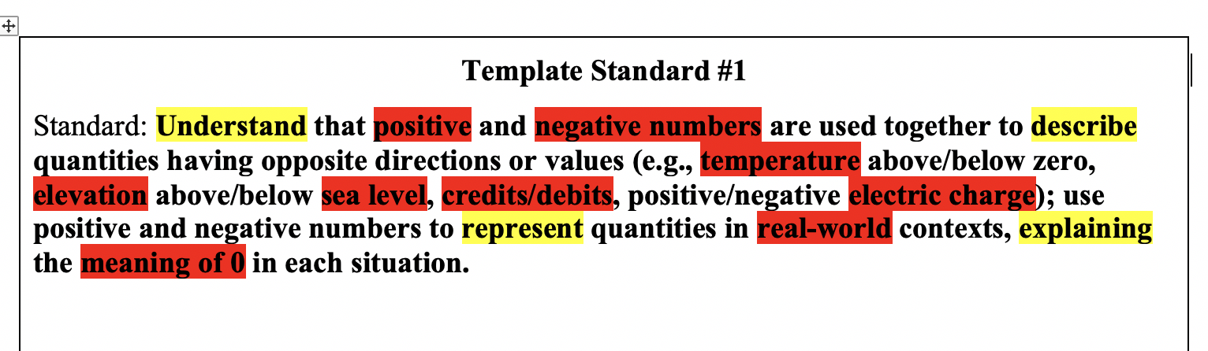
Highlight the verbs with one color (Yellow) and the nouns with a different color (RED).
DECONSTRUCTING STANDARDS

Slide 74
Knowledge targets:
Know the meaning of the following words and concepts:
-positive numbers
-negative numbers
-temperature
-elevation
-sea level
-credits/debits
-electric charge
-real world
-meaning of 0
DECONSTRUCTING STANDARDS

Slide 75
Reasoning targets:
Understand that positive and negative numbers can be used together to describe quantities.
Apply the concept of positive and negative numbers in a real world example.
Explain the meaning of the value of 0 in that real world example.
DECONSTRUCTING STANDARDS

Slide 76
Skills targets:
None
DECONSTRUCTING STANDARDS

Slide 77
Product targets:
Creation of “real world” examples. This would be an authentic assessment of the standard.
DECONSTRUCTING STANDARDS

Slide 78
We hope that helps you.
DECONSTRUCTING STANDARDS

Slide 79
We will start again tomorrow morning at 9:00.
Mahalo and see you in the morning.
DECONSTRUCTING STANDARDS

